Slide 1

Job Market Analysis & Recommendation System
Nexthikes internship
Presented by khushnaz

Slide 2
Project Overview
• Objective: Analyze job market trends and build a recommendation system
• Dataset: Job postings with features like title, salary, location, category, etc.
• Deliverables: Data analysis, ML/DL models, web deployment
• Tools: Python, Pandas, Scikit-learn, Streamlit

Slide 3
Data Preprocessing
• Handled missing values and duplicates
• Extracted features: job title keywords, hourly/fixed salary, budget
• Encoded categorical variables (country, remote, etc.)
• Created new columns: year, month, day of week

Slide 4
Task 1 – Salary Analysis
• Correlation between job title keywords and salary
• Identified top keywords associated with high salaries
• Example: 'engineer', 'data', 'consultant'

Slide 5
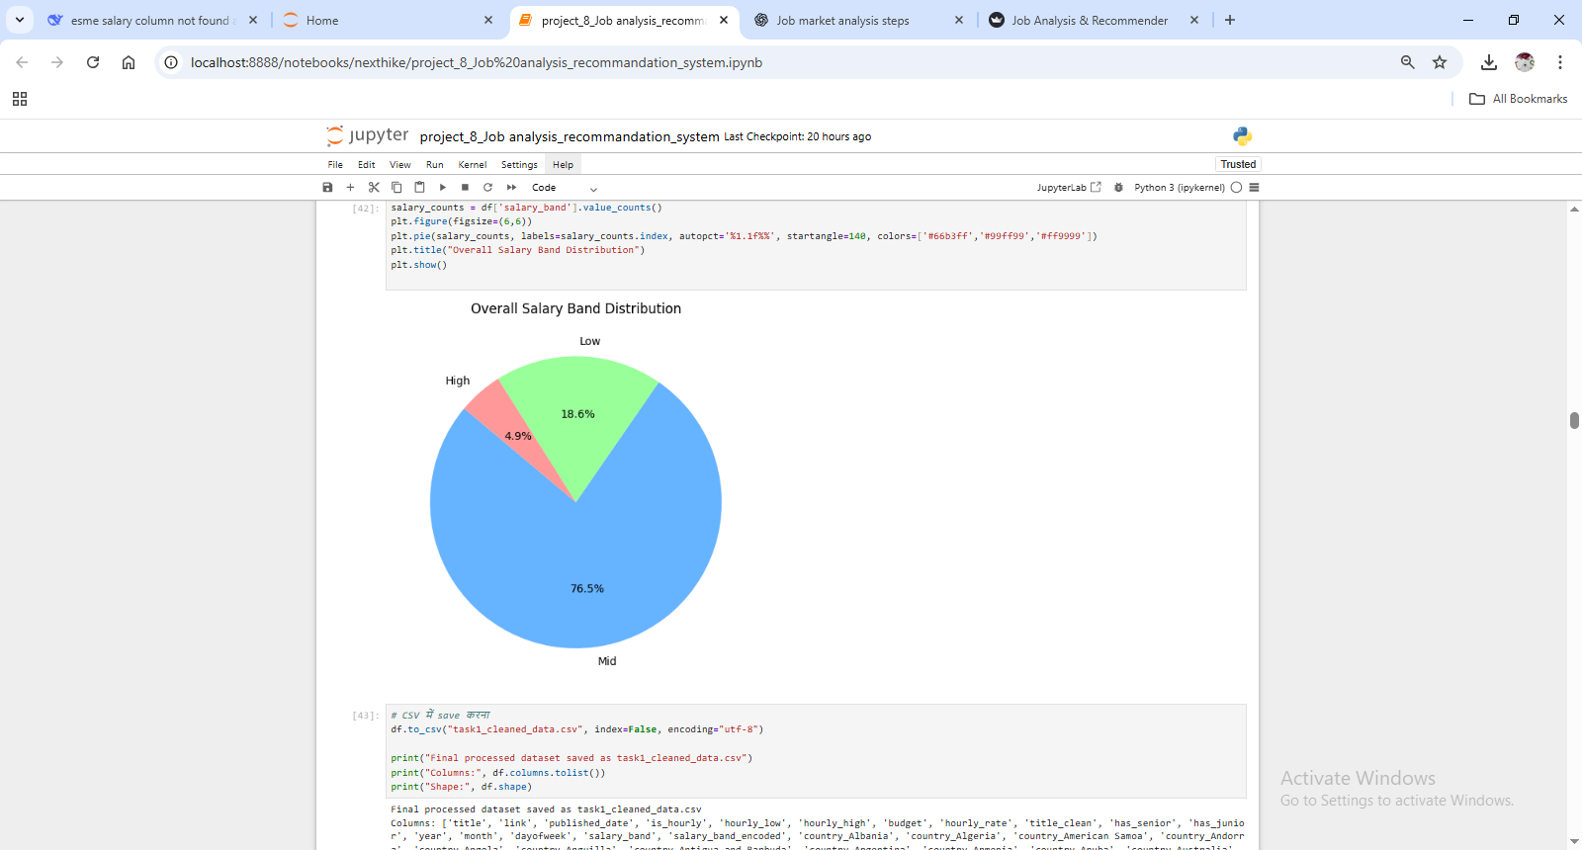
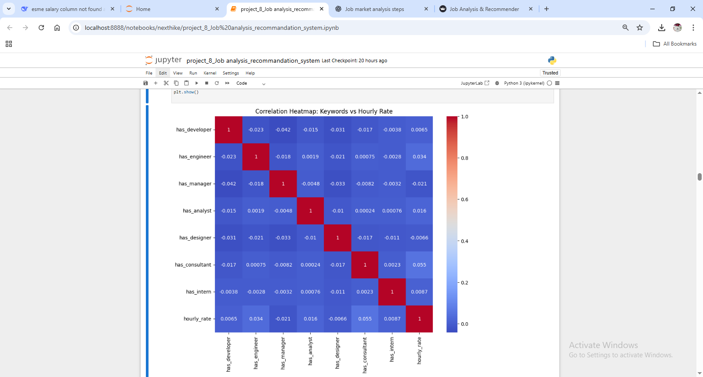

Slide 6
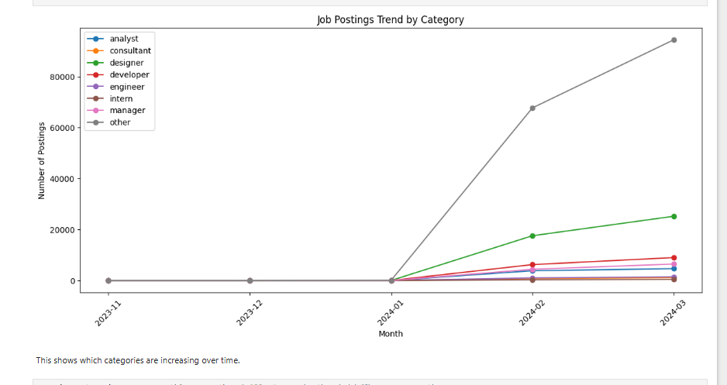
Task 2 – Emerging Job Categories
• Analyzed posting frequency across categories over time
• Identified fast-growing categories
• Visualization: line chart by month

Slide 7
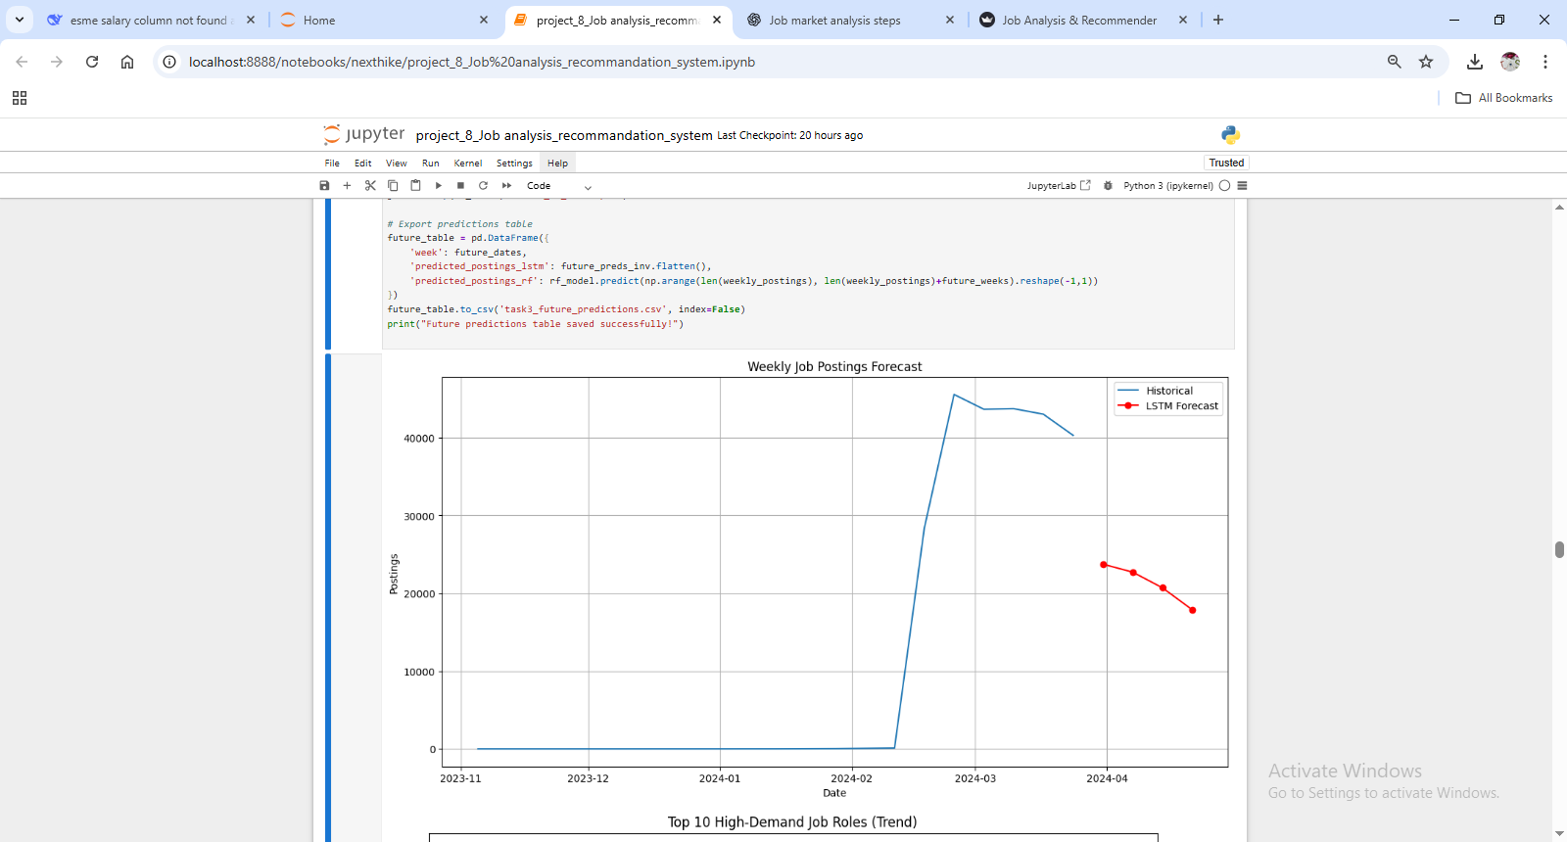
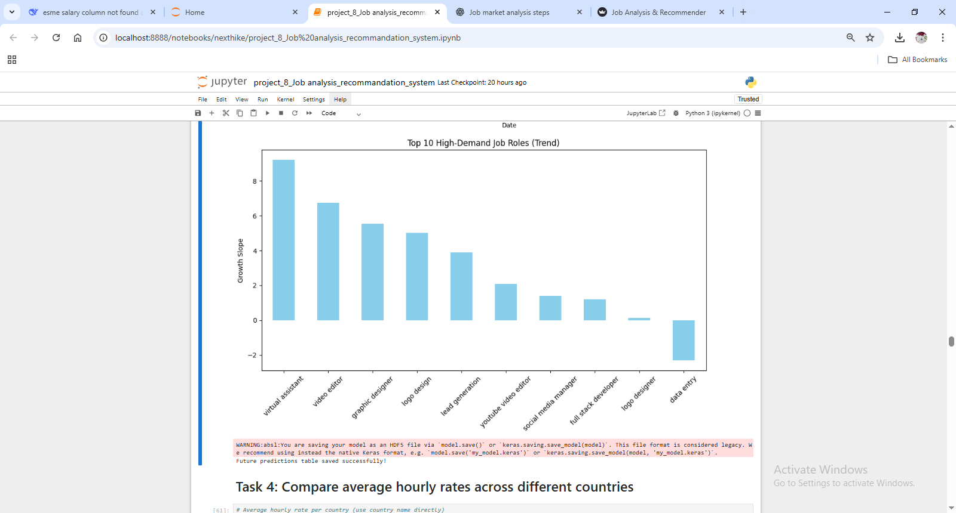
Task 3 – Predict High-Demand Roles
• Built forecasting models (Prophet, ARIMA, LSTM)
• Predicted monthly demand for job roles
• Example: Data Scientist, ML Engineer roles increasing

Slide 8
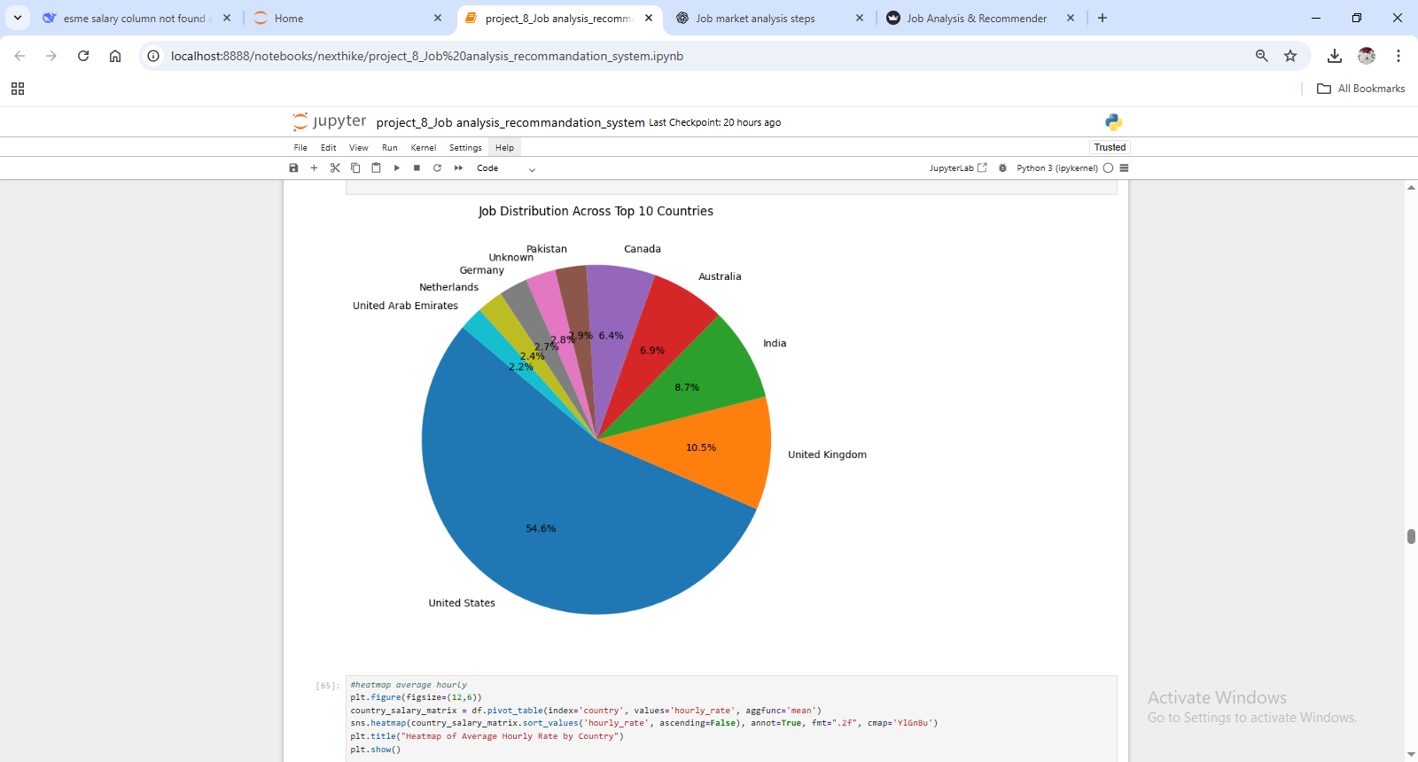
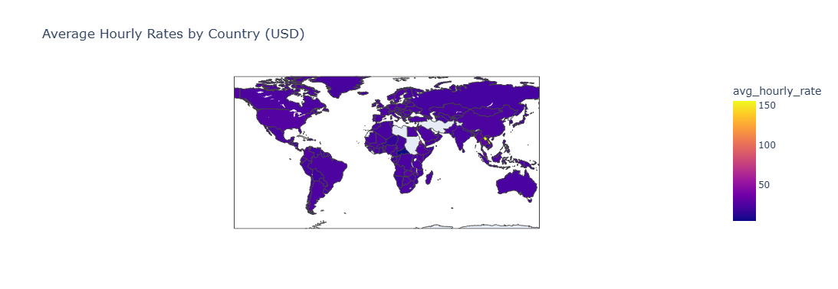
Task 4 – Salary by Country
• Computed average hourly rate per country
• Visualization: Choropleth map & bar chart
• Identified top-paying countries

Slide 9
Task 5 – Job Recommendation System
• Content-based recommendation using job descriptions
• TF-IDF + Cosine similarity for matching
• Suggested top similar jobs for user input

Slide 10
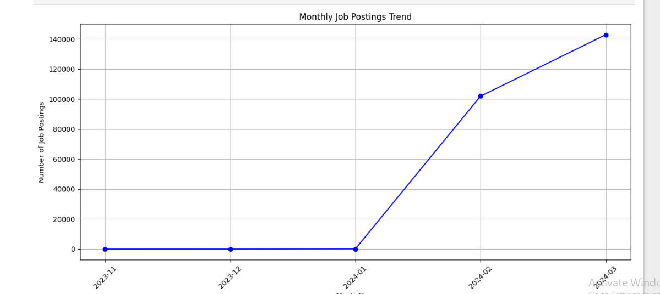
Task 6 – Monthly Dashboard
• Designed Streamlit dashboard to update monthly
• Visualized trends in salary, categories, and remote work
• Automated with data pipeline for real-time updates

Slide 11
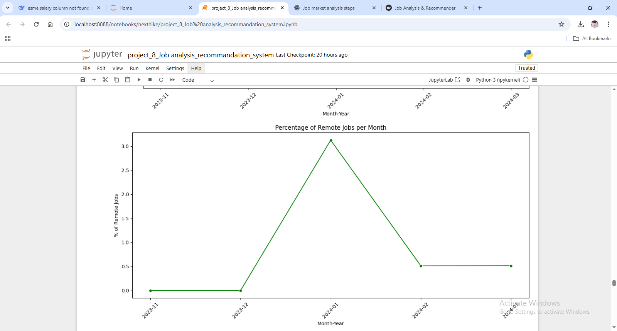
Task 7 – Remote Work Trends
• Analyzed remote vs onsite job postings over time
• Found increase in remote opportunities post-pandemic
• Visualization: line chart by month

Slide 12
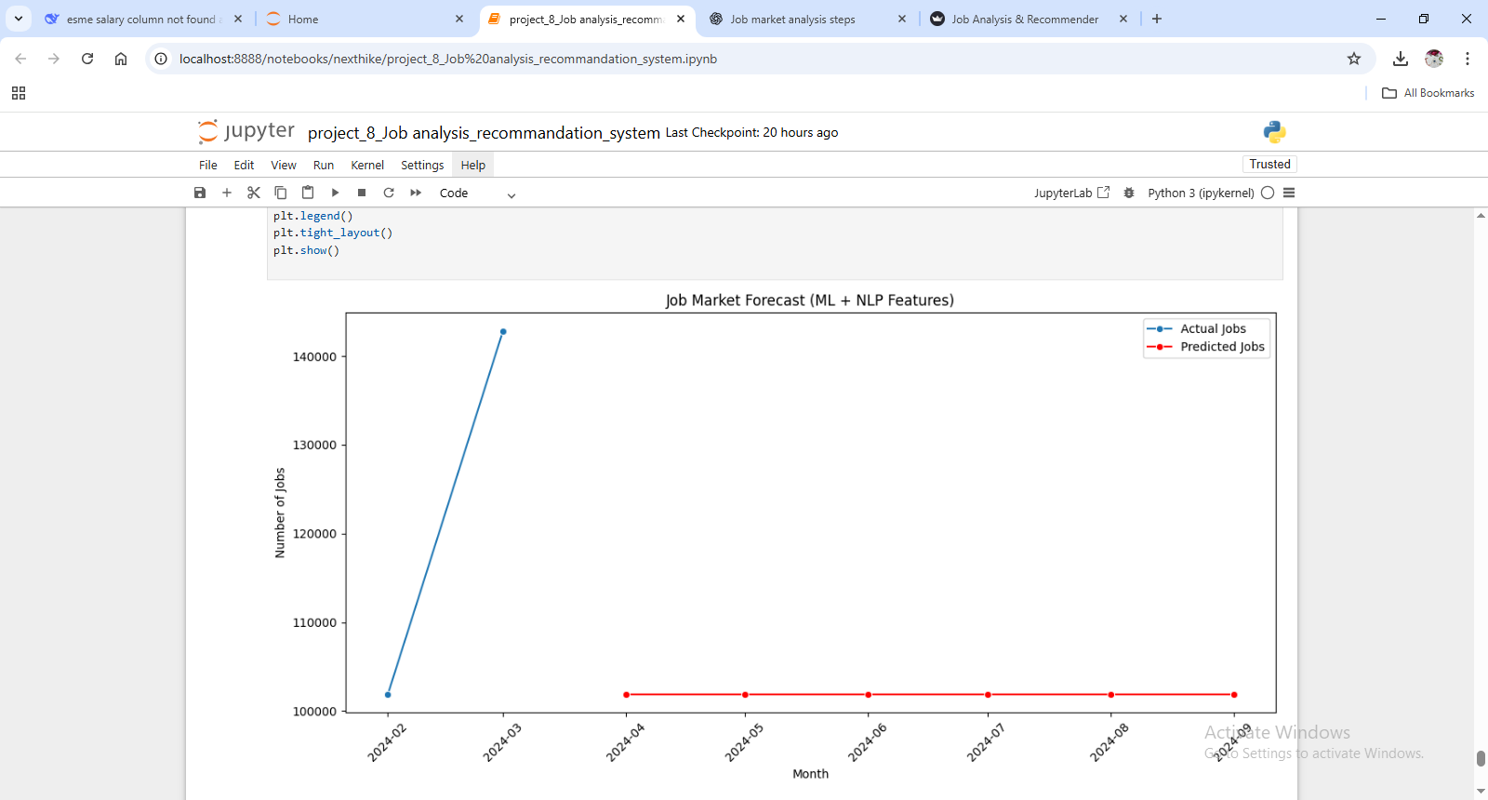
Task 8 – Future Job Market Trends
• Predicted future demand using forecasting models
• Exported insights and recommendations
• Provided scenarios for job seekers and employers

Slide 13
Web Deployment
• Built Streamlit web app covering all tasks
• Modules: Salary Analysis, Categories, Forecasting, Recommendation, Dashboard
• Deployment: Streamlit Cloud / Docker
• Interactive job insights for users

Slide 14
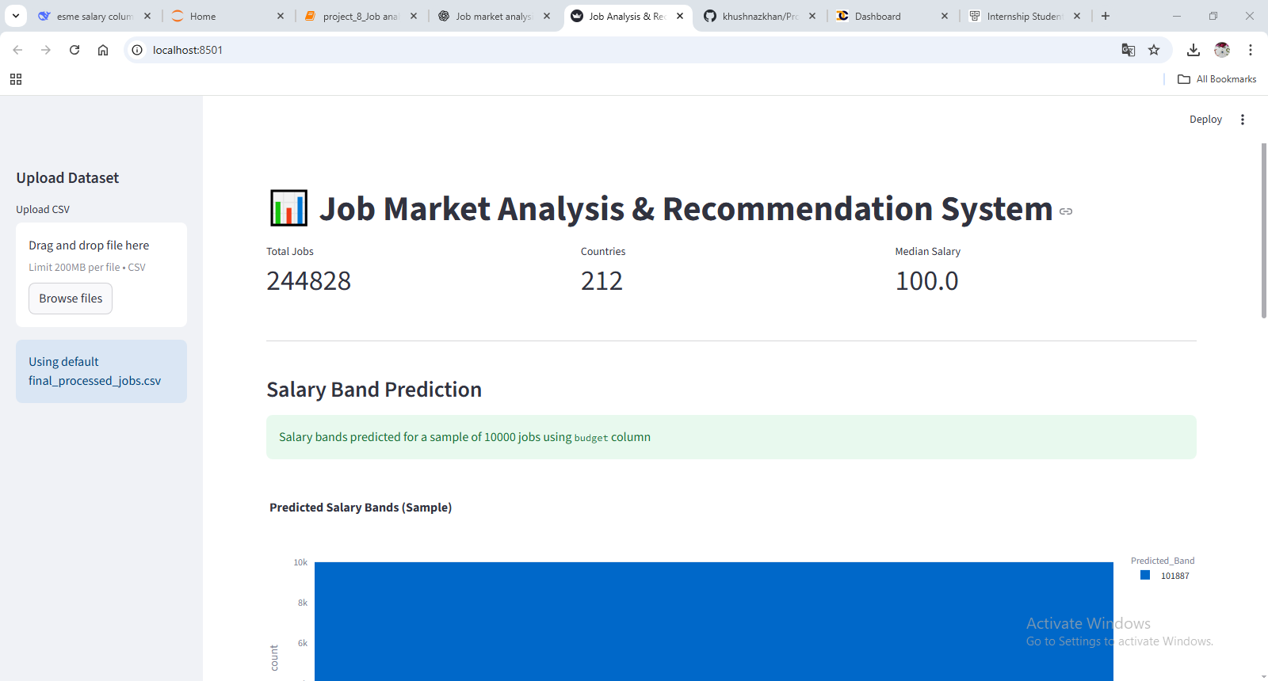
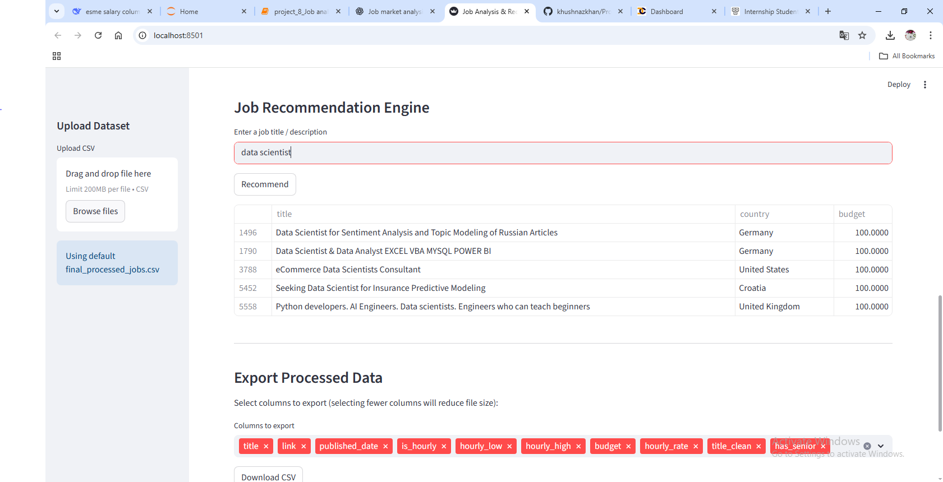
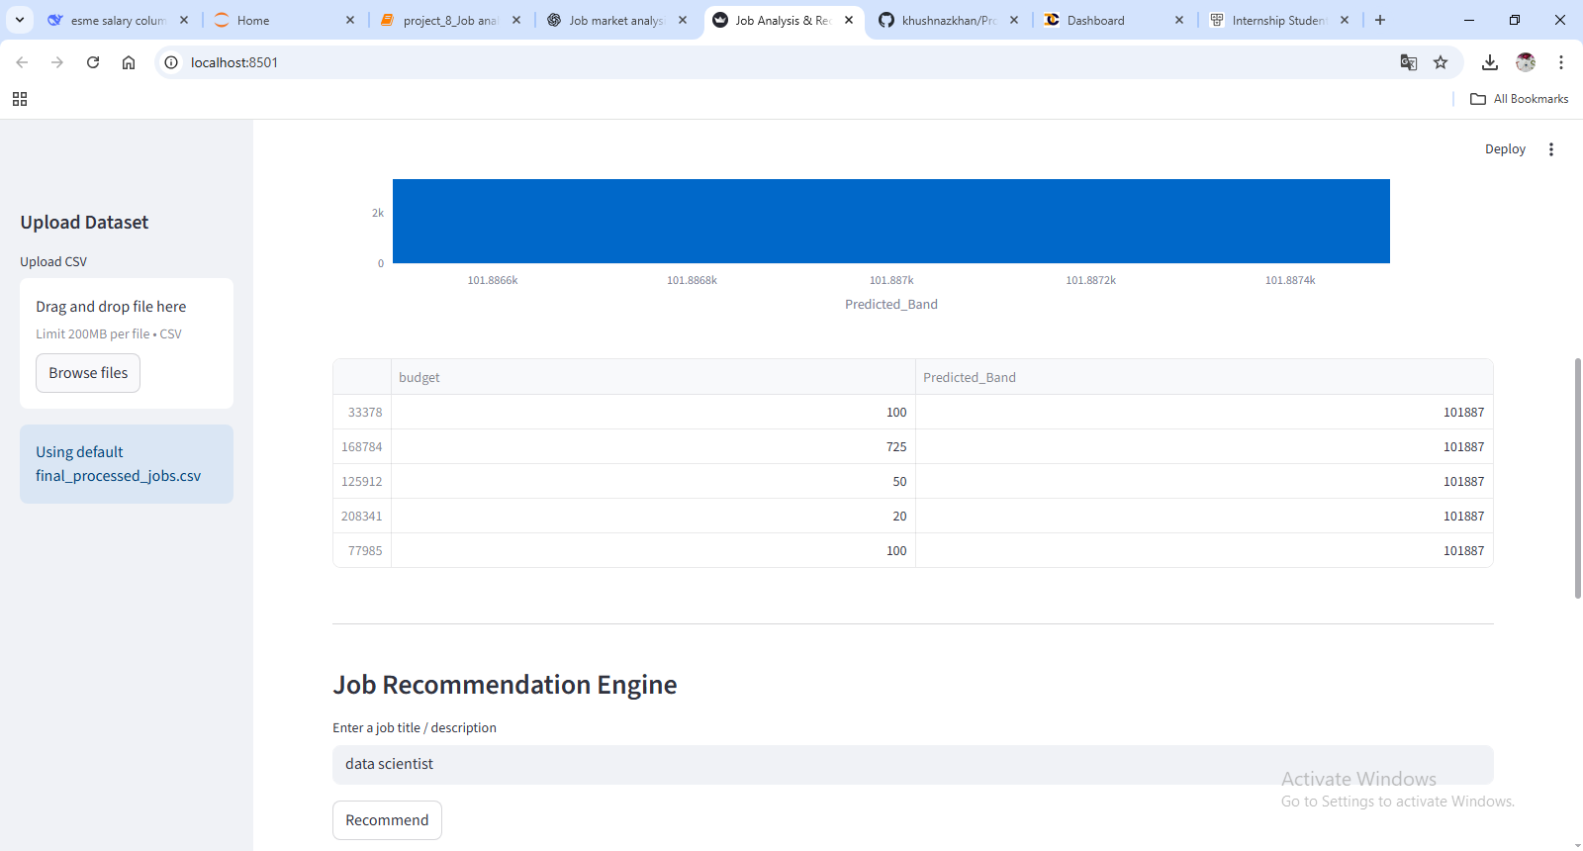

Slide 15
Conclusion
• Successfully analyzed job market trends
• Built salary prediction and recommendation system
• Developed interactive dashboard
• Useful for job seekers and recruiters
• Future: Expand dataset, improve ML/DL models

Slide 16
Thank you

